Slide 1
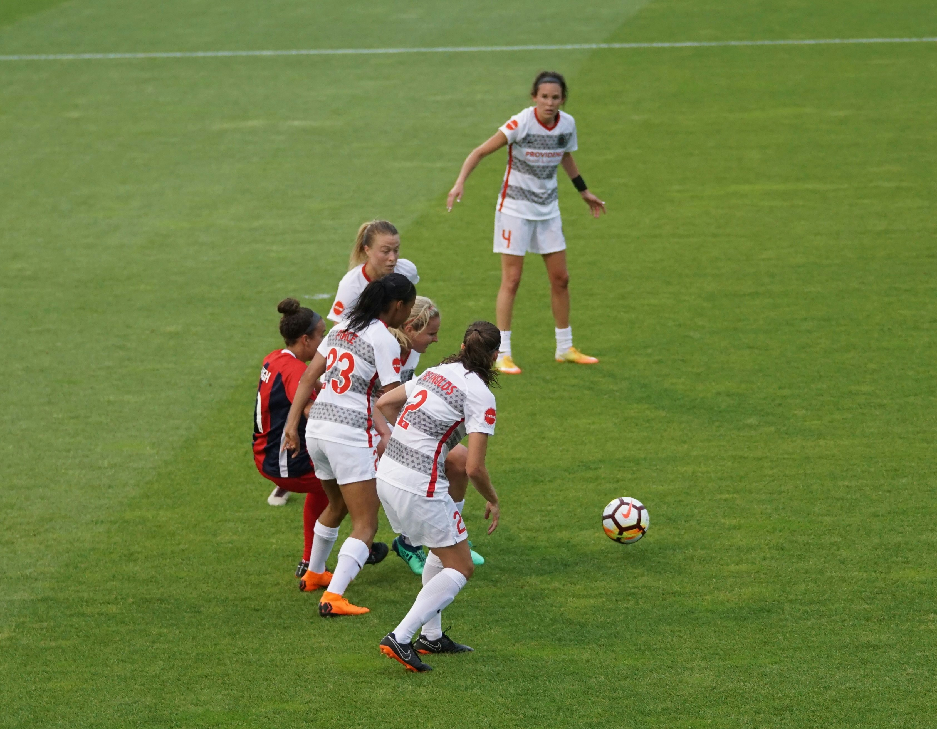
Capstone Project:
FOOTBALL GAME DATASET ANALYSIS
Created By Anjali Thota
Batch:DA326S32
Mentored By Komilla Bhatia

Slide 2
PROBLEM STATEMENT
The project is to analysed a football dataset to identify key factors for success, specifically within areas such as player performance, team tactics, fan behavior.
The data that can be used to enhance decision-making in football.
OBJECTIVES
Performance Analysis
Player Profile and Market Value
Team Comparison
Attendance and Stadium Analysis
Substitution Patterns
Event Analysis

Slide 3






Project Procedure
Excel :
LOADING DATA SETS
PYTHON
DATA PREPROCESSING AND ML ALGORITHAMS
TABLEAU:
FINDING BUSINESS INSIGHTS
FIGMA:
BACKGROUND DESIGN FOR FIGMA
MY SQLWORKBENCH :
For Analyzing the Data
Excel: Excel is using for importing and exporting data sets.
MY SQL WORKBENCH: For Analyzing the Data.
Python: Python using the commonly used for merging tables and preprocessing data.
Tableau:Tableau is a powerful data visualization tool that can be used to create a variety of charts and graphs.
Figma: Figma is a design tool that can be used to create backgrounds and other visual elements

Slide 4
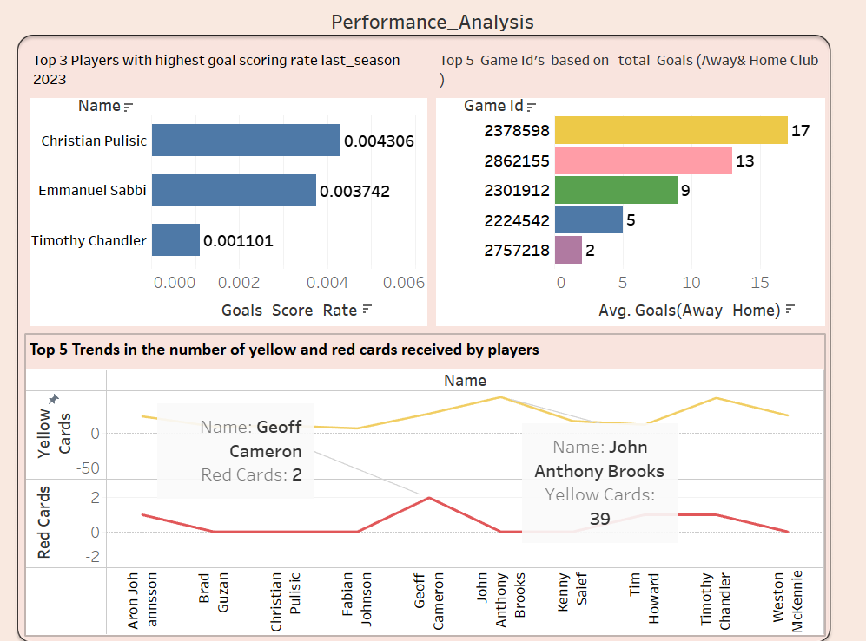
Christian Pulisic has the highest goal scoring(sum Goals by sum minutes) rate at 0.004306.
Game ID 2378598 has the highest total goals, with 17.
Game ID 2757218 has the lowest total goals, with 2.
John Anthony has received the most yellow cards, with 39.
Geoff Cameron has received the most red cards, with 2.

Slide 5
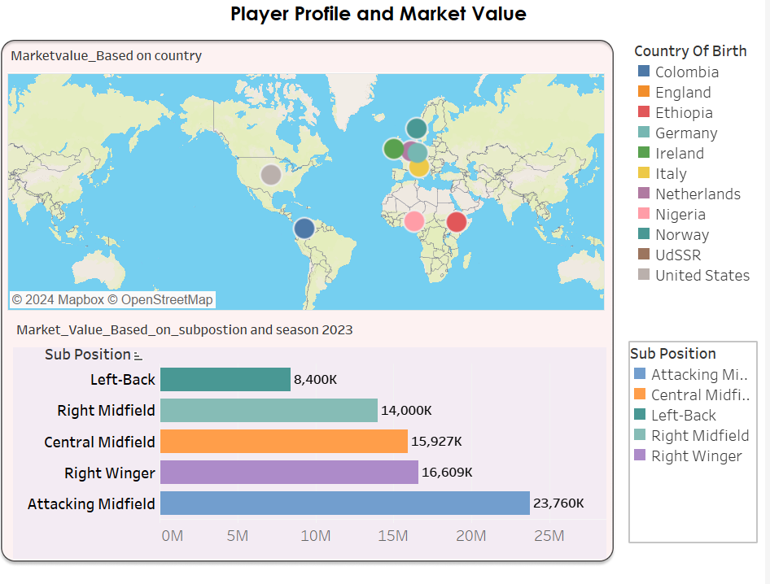
Players from Colombia have the highest Avg Market Value at
30,000,000 In Eur.
Ethiopia have the lowest average 1,50,000 market values.
Attacking Midfielders have the highest 23,760 k average market value Based on subpostion.
Left Winger have the lowest average market value 8,400k

Slide 6
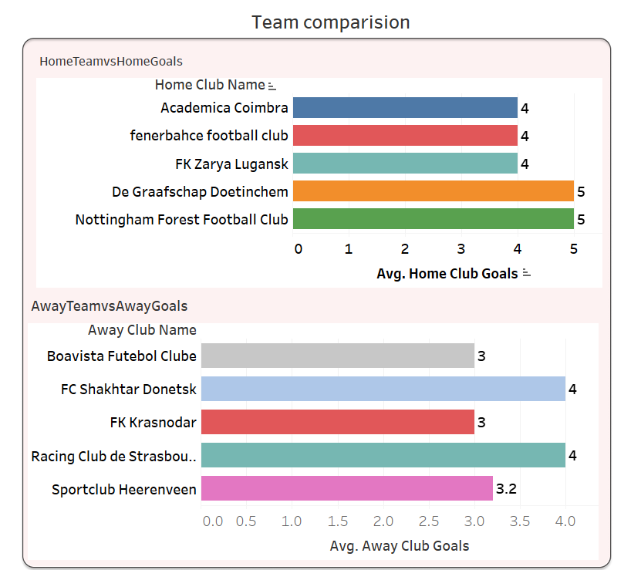
Top 5 Higher average Home club Goals of Home Teams and Nottingham Forest Football Club having the highest Goals 5
Top 5 Higher average AWAY club Goals of Home Teams having the highest goals of name FC Shakhtar and Racing Club de Krasnodar with Goals 4

Slide 7
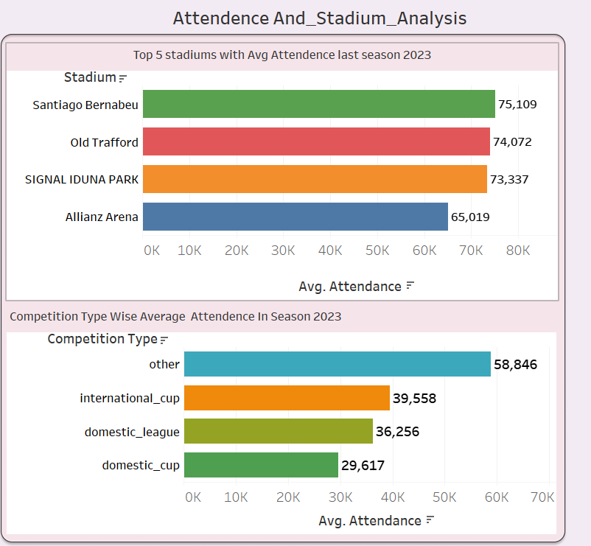
Stadium with average attendance
Of
Santiago Bernabeu leads the Highest average attendance of 75,109.k
ALLIANZ ARENA leads the low average attendance of 65,019k.
Competition wise average attendance of
Other competitions have the highest average attendance of 58,846 k.
International cup matches attract an average of 39,558 k.

Slide 8
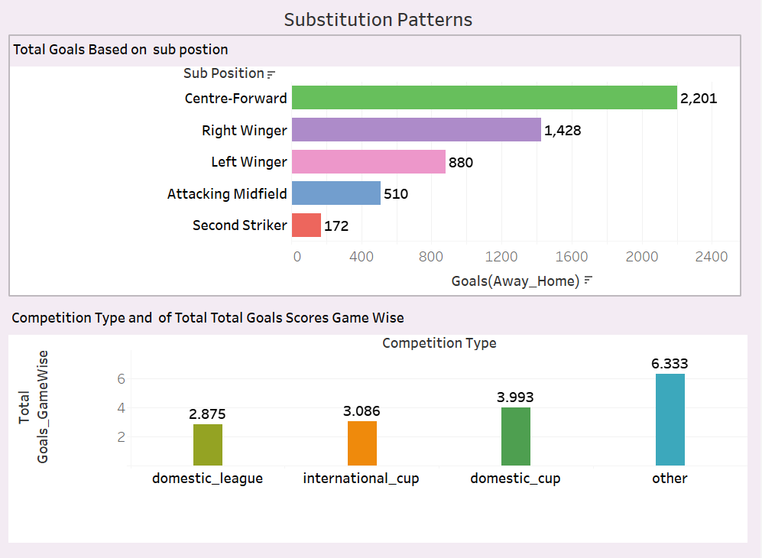
Based Top 5 goals based subpostion Centre-forward substitutions have resulted in the most goals, with a total of 2,201.
Second Striker Having the less 172 Goals.
Competition type based total goals scoring game wise
Others have the highest goals 6.33
domostic_cup matches have a slightly second higher of total goals scored 3.993 compared to international league matches, at 3.086

Slide 9
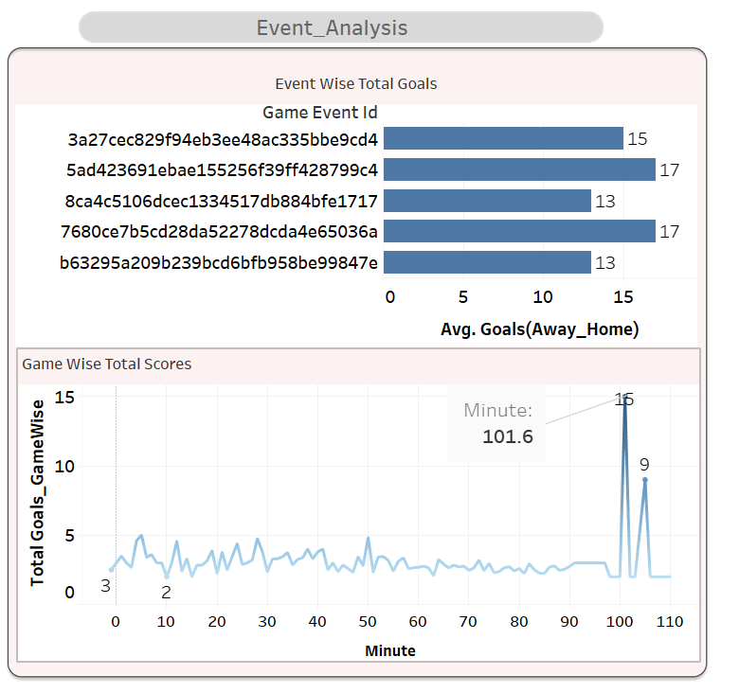
Based Top 5 Game Event ID’s In That 3a27cec829f94eb3ee48ac335bbe9cd4 has the highest total goals, with 17.
Top 5 Goals Based on
Game wise minutes playing
101.6 minutes havening the highest Goals 15

Slide 10
ML ALGORITHMS
Linear Regression:
Purpose: Predicts the future market value of a player.
Input features: Player details such as goals, last season's performance, minutes played, home/away club goals, height, and attendance.
Output: Predicted market value.
Logistic Regression:
Purpose: Predicts whether a player will receive a card in the future.
Input features: Player details such as minutes played, last season's performance, and market value.
Output: Predicted probability of receiving a card (0 or 1).
K-means:
Purpose: Predict the Clusters players based on their characteristics to identify groups with similar attributes.
Input features: Player details such minutes played, last season’s ,market value.
Output: Clusters of players 4.

Slide 11
SUMMARY
Performance Analysis
Christian Pulisic has the highest goal scoring rate at 0.004306(sum of goals by sum of minutes)
Game ID 2378598 has the highest total goals, with 17.
Game ID 2757218 has the lowest total goals, with 2.
John Anthony has received the most yellow cards, with 39.
Geoff Cameron has received the most red cards, with 2.
Player Profile and Market Value
Players from Colombia have the highest Avg Market Value at 30,000,000 In Eur.
Ethiopia have the lowest average 1,50,000 market values.
Attacking Midfielders have the highest 23,760 k average market value Based on subpostion.
Left Winger have the lowest average market value 8,400k

Slide 12
SUMMARY
Attendance and Stadium Analysis
Stadium with average attendance Of Santiago Bernabeu leads the Highest average attendance of 75,109k.
ALLIANZ ARENA leads the low average attendance of 65,019k.
Competition wise average attendance of Other competitions have the highest average attendance of 58,846 k.
International cup matches attract an average of 39,558 k.
Substitution Patterns
Based Top 5 goals based subpostion Centre-forward substitutions have resulted in the most goals, with a total of 2,201.
Second Striker Having the less 172 Goals.
Competition type based total goals scoring game wise
Others have the highest goals 6.33
domostic_cup matches have a slightly second higher of total goals scored 3.993 compared to international league matches, at 3.086

Slide 13
SUMMARY
Event Analysis
Game ID 2757218 has the highest total goals, with 17.
Game ID 2231415 has the lowest total goals, with 2.
Game Event ID 3a27cec829f94eb3ee48ac335bbe9cd4 has the highest total goals, with 15.
Game Event ID b717041d1fc6293fdc07cdf7f2cb438d has the lowest total goals, with 3.

Slide 14
Conclusion
Christian Pulisic led the last season (2023) in goal-scoring rate, with a rate of 0.004306,
The game with ID 2378598 had the highest number of total goals scored (17) by both home and away clubs, indicating it was a high-scoring event.
The map indicates a concentration of players in Europe, particularly in England, Germany, Italy, and Spain. This suggests that these regions are major hubs for football needed to improvement.
The average number of goals scored by home teams (4) is slightly higher than that of away teams (3.4)
The Santiago Bernabeu leads the list of top 5 stadiums with the highest average attendance
The "other" category, which likely includes a mix of different competitions, has the highest average attendance, followed by international cups and domestic leagues.
The match featured a total of 35 goals, with an average of 17.5 goals per team. This suggests that the match was relatively high scoring.

Slide 15
THANK YOU

